Slide 1
Generative Adversarial Network (GAN)
advanced ML architecture

Slide 2
Overview
What is GAN?

Slide 3
Overview
A Generative Adversarial Network is a machine learning technique.
It uses a game-like competitive dynamic between two neural networks to generate fake examples.
The two neural networks are known as the Generator and the Discriminator
Generator produces fake data that resembles the training dataset.
Discriminator correctly determines whether a particular example is real or fake.

Slide 4
Overview Continued
The GANs belong to the set of algorithms called generative models
Generative models belong to the field of unsupervised algorithms
There are different applications of GANs:
Photo Blending
Live Demo: https://thispersondoesnotexist.com/
Text-to-Image Generation
Deepfakes

Slide 5
Training GANs
The Discriminator is trained to classify the input data as either real or fake.
It is trained using real data and generated fake data, to distinguish between them.
The Generator is trained to fool the Discriminator by generating data as realistic as possible.
Its parameters are adjusted to improve its ability to fool discriminator.
The training ends successfully when discriminator is unable to differentiate between real and generated data with reasonable accuracy.

Slide 6
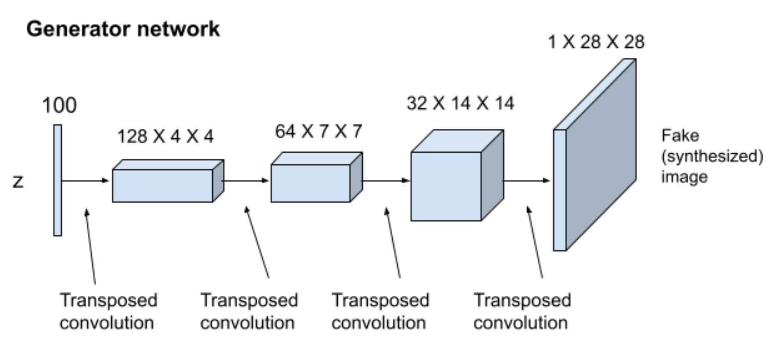
Convolution GAN
A CGAN is a type of GAN architecture that incorporates convolutional neural networks (CNNs) to generate high-quality images.
Both generators and discriminators are designed using transposed convolutional layers.
The generator takes random noise as input and transforms to an image by adding zeros between input elements.

Slide 7
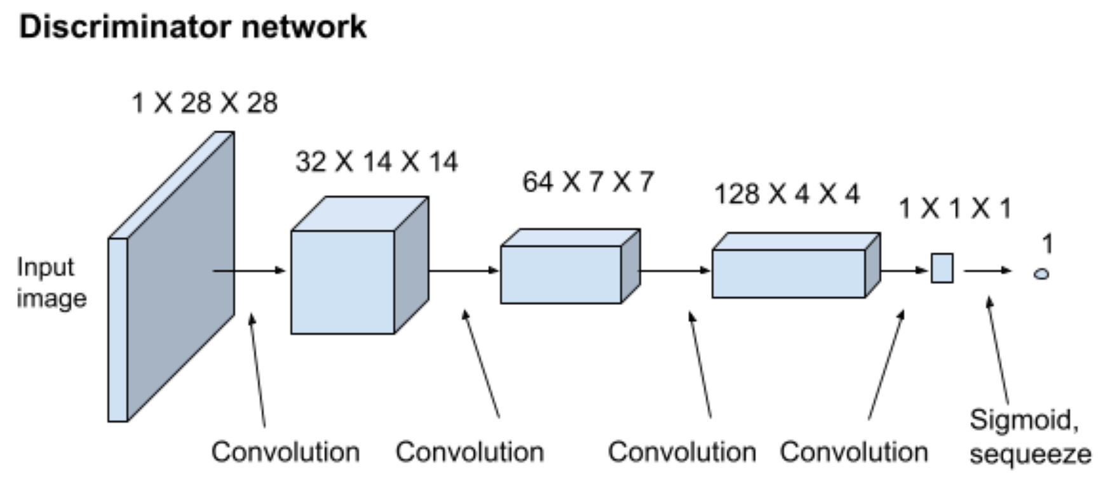
Convolution GAN
The discriminator uses different convolutional layers to identify both real and generated images.
Sigmoid squeeze converts output to a value between 0 and 1 and assigns them as real or fake.
This enables the discriminator network to differentiate between real and fake data.

Slide 8
Code
Open CGAN_MNIST_Template.ipynb
Add the code indicated by red arrows

Slide 9
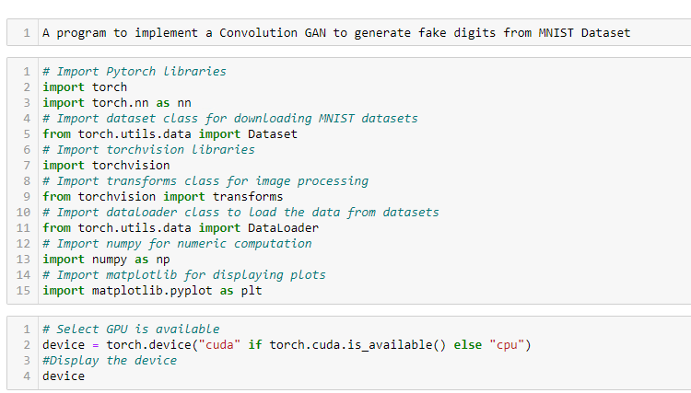
Code

Slide 10
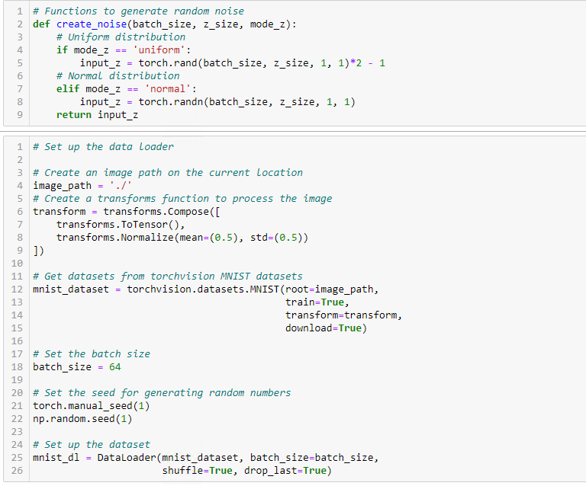
Code

Slide 11
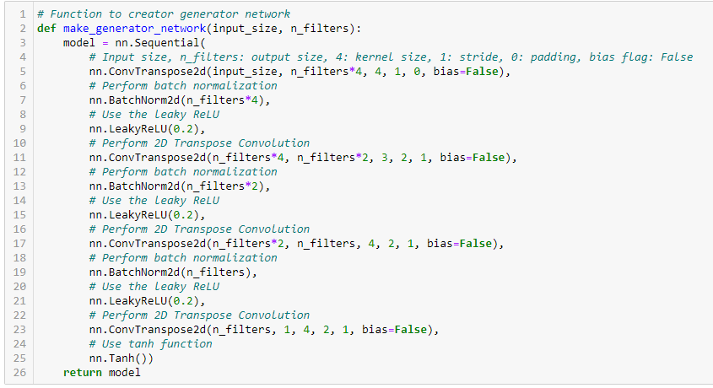
Code

Slide 12
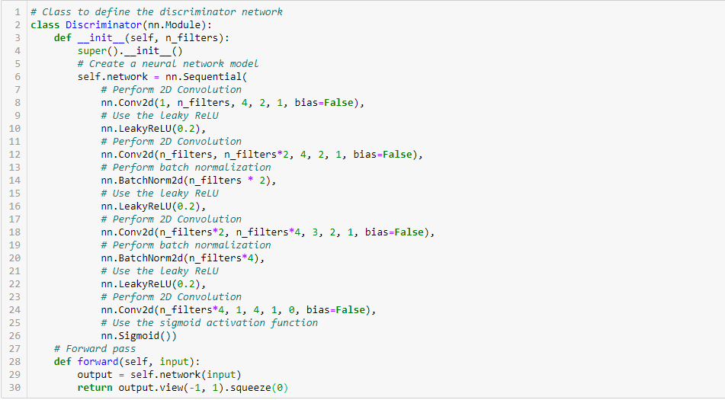
Code

Slide 13
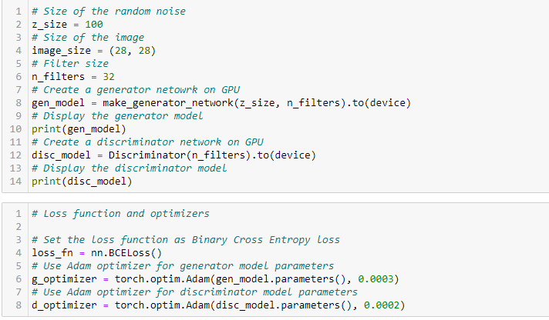
Code

Slide 14
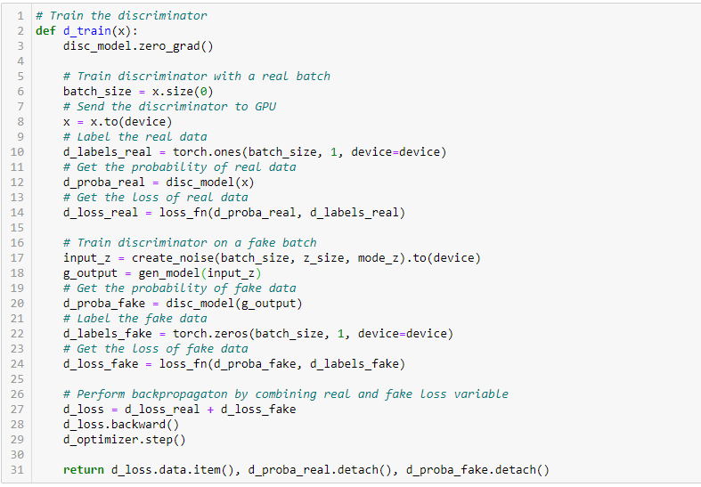
Code

Slide 15
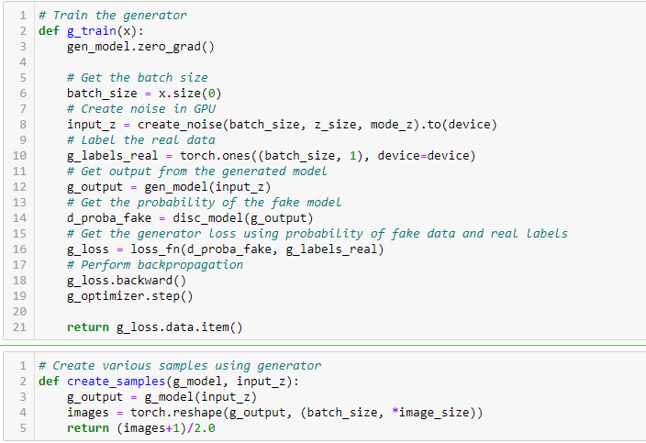
Code

Slide 16
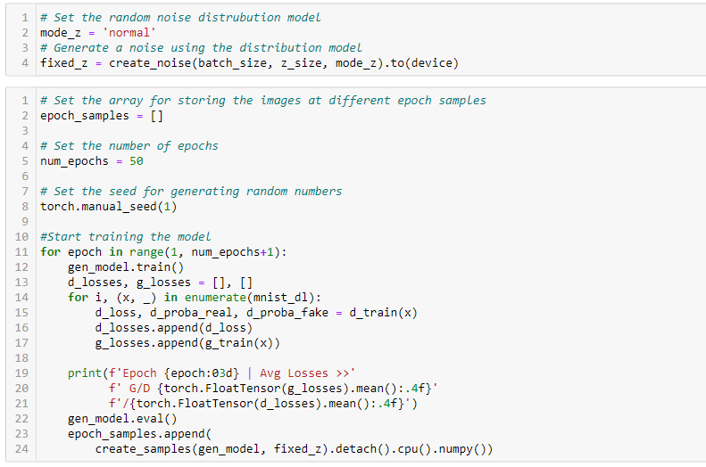
Code

Slide 17
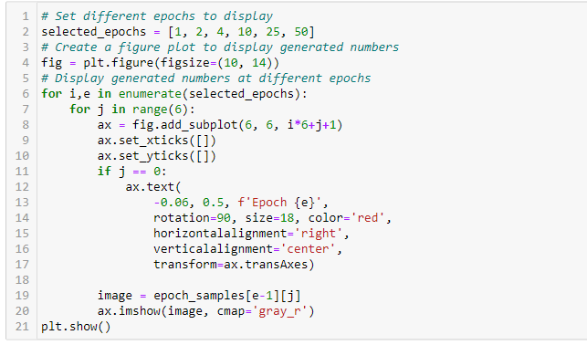
Code

Slide 18
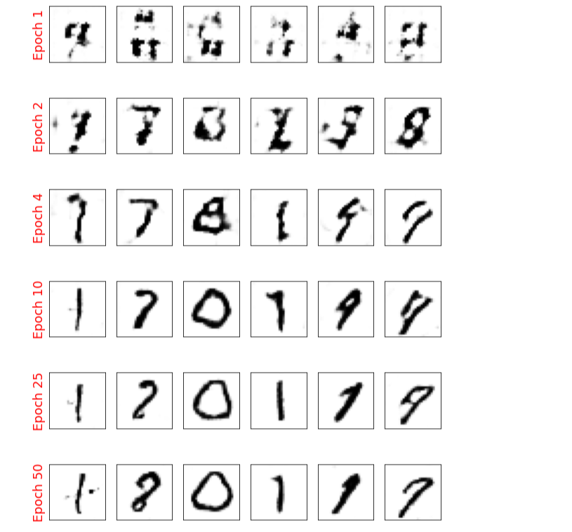
Final Output

